Slide 1
Proyecto Final Advanced Programming
Bryan Figueroa Maldonado Est. # 127677
Victor Vallin Avila Est. # 62546
15 de octubre de 2019.

Slide 2
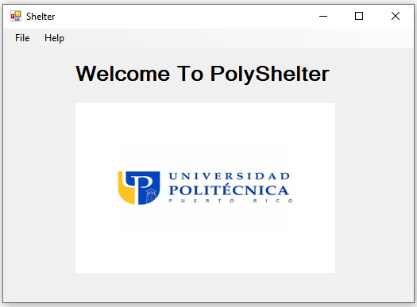
POLYSHELTER MENU

Slide 3
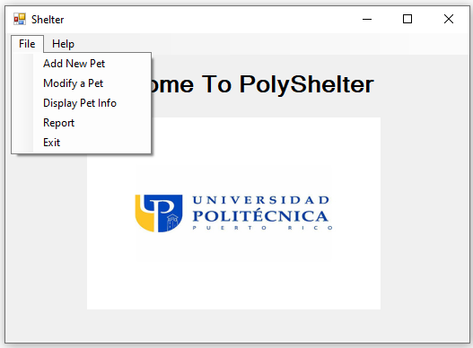
POLYSHELTER FILE BUTTON
¡

Slide 4
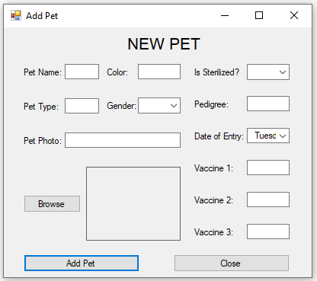
POLYSHELTER ADD PET BUTTON

Slide 5
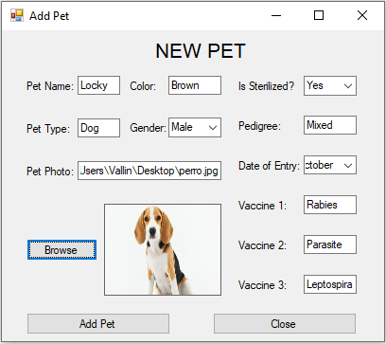
POLYSHELTER ADDED PET

Slide 6
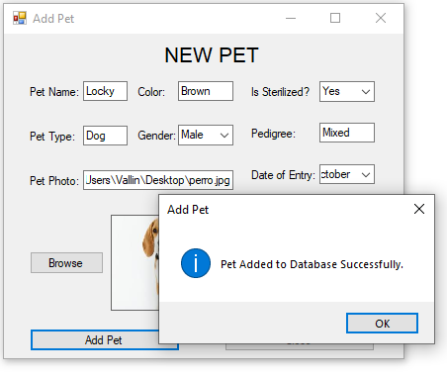
POLYSHELTER NEW PET ADDED

Slide 7
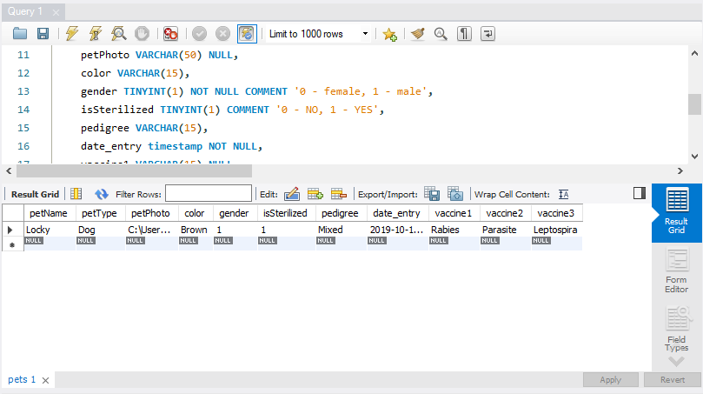
POLYSHELTER DATABASE
¡

Slide 8
POLYSHELTER FILE BUTTON
¡

Slide 9
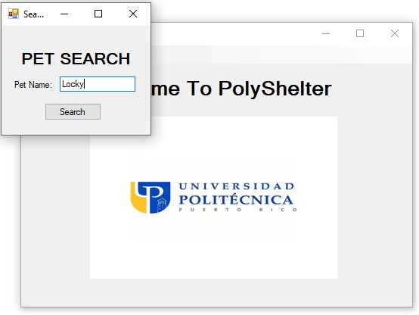
POLYSHELTER MODIFY BUTTON

Slide 10
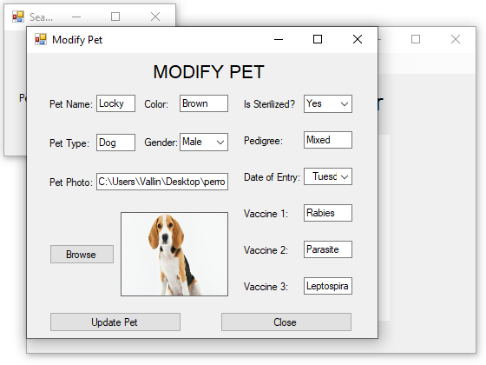
POLYSHELTER SEARCH (MODIFY) BUTTON

Slide 11
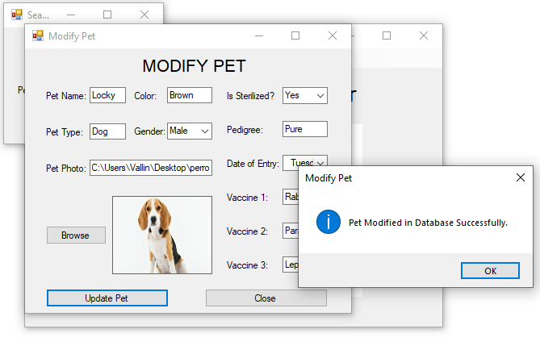
POLYSHELTER MODIFIED PET ADDED

Slide 12
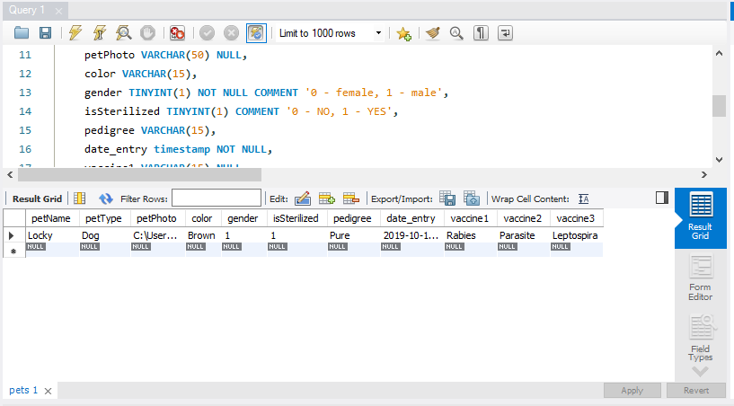
POLYSHELTER DATABASE

Slide 13
POLYSHELTER FILE BUTTON
¡

Slide 14
POLYSHELTER DISPLAY INFO BUTTON

Slide 15
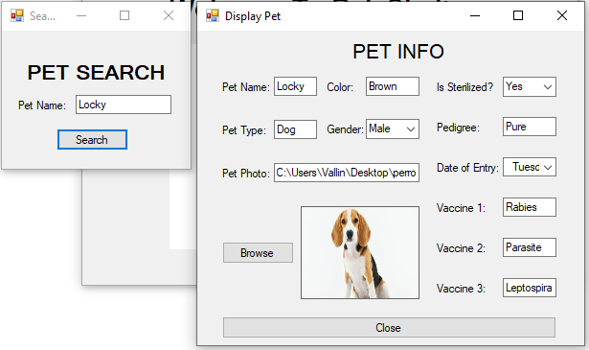
POLYSHELTER SEARCH (DISPLAY) BUTTON

Slide 16
POLYSHELTER FILE BUTTON
¡

Slide 17
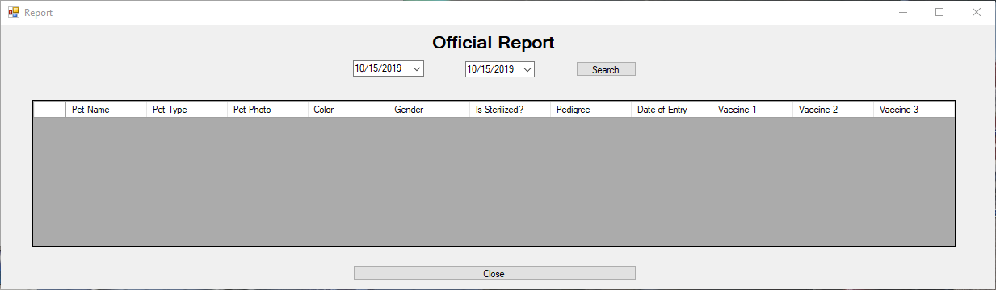
POLYSHELTER REPORT BUTTON

Slide 18
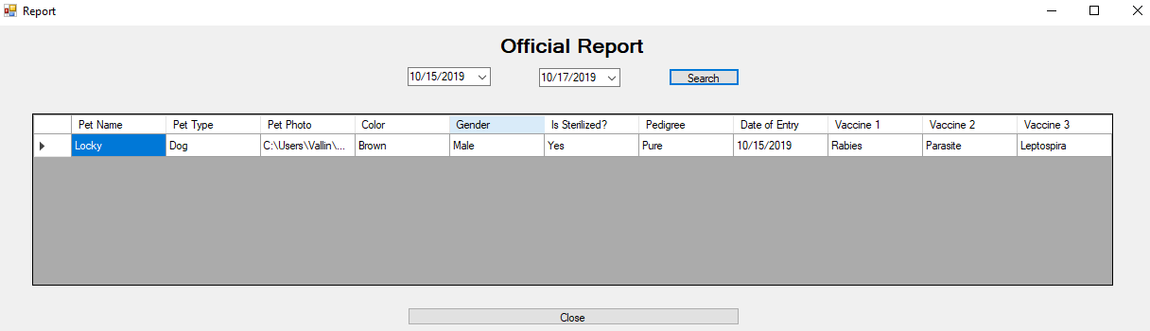
POLYSHELTER SEARCH (REPORT) BUTTON

Slide 19
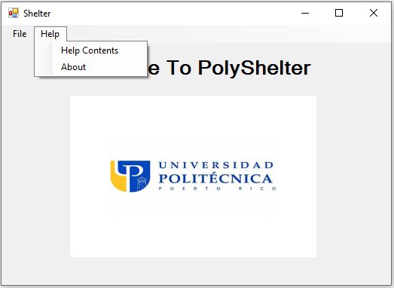
POLYSHELTER HELP BUTTON

Slide 20
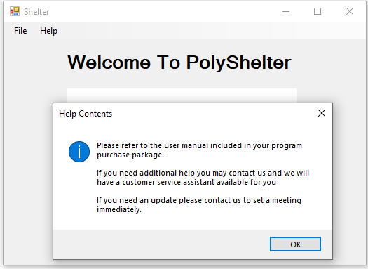
POLYSHELTER HELP CONTENTS BUTTON

Slide 21
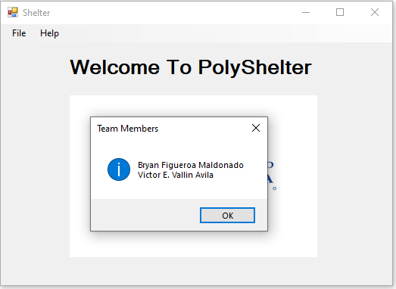
POLYSHELTER ABOUT BUTTON

Slide 22
PRECIO DEL PROGRAMA

Slide 23
¡GRACIAS POR SU ATENCION!

